Slide 1

Implementation of the Water Resources Classification System and Determination of the Resource Quality Objectives for Significant Water Resources in the Letaba Catchment
Public Meeting
12 June 2014
Notes:
DWA, as the custodian of countries water resources has arrange this meeting to discuss the Classification and Resource Quality Objectives
that are proposed for the Letaba River System.

Slide 2


Slide 3
Purpose of the meeting
Present and discuss the Classification of the water resources of the Letaba River catchment.
Introduce the Resource Quality Objectives - goals defining the quality of the water resource according to the classification.
Request comments and solicit participation.
Notes:
DWA representative to present

Slide 4
INTEGRATED WATER RESOURCE MANAGEMENT
Catchment
Vision
Societal values and aspirations
Desired state of water resources
Catchment Assessment including current state
Management Class
Monitoring
Determine RQOs and Reserve
Compliance
State
Catchment Management Strategy
Water Use Control
Resource Management Strategy
Source Directed Management Strategy
Other strategies
End of pipe standards
Management plans
Water use authorisations
Allocation schedule (quality and quantity)
Strategic use; International obligations;
future use;
inter-basin transfers

Slide 5
Legal Mandate
National Water Act requires:
  Classification of water resources
    Prepared in accordance with the National Water Resource Classification System.
  Resource Quality Objectives
    Defines the goals to achieve the Management Class, numerically and as narratives.
Notes:
DWA representative to present

Slide 6
What is Classification ?
Classification defines the desired state of the water resources by setting a Management Class (MC);
Recommended MC reflects a balance between protection and use of the water resources;
This balance was determined by taking into account the social, economic & ecological landscape;
Process requires co-operation & transparency with all stakeholders.
Notes:
DWA representative to present

Slide 7
What are the classes?
Classes | Description of use | Majority of ecological categories
Class I | Minimally used | A & B
Class II | Moderately used | C
Class III | Heavily used | D
Ecological Category (EC) - means the assigned ecological condition to a water resource . It is measured by determining how much the ecosystem has changed from natural (pre-development condition).
Notes:
DWA representative to present:
Summary statements
Explain how this links to the following presentations.

Slide 8
Stakeholder Involvement
Established a Project Steering Committee to guide process
  3 meetings (March, October 2013 and April 2014)
Information dissemination:
  Advertisements and invitation letters
  BIDs and Newsletters
  Meetings with sectors
Notes:
DWA representative to present:
The process was guided by a Project Steering Committee that was established in March 2013.
The PSC was kept informed and the recommendations were presented at the April 2014 meeting.
Throughout the process comments were received and incorporated in the process.

Slide 9
Were are we in the process?
Six of the seven Classification and Resource Quality Objective Steps are completed.
Proposed Management Classes and Resource Quality Objectives have been compiled and will be presented.
Publishing in the Gazette is underway.
Notes:
DWA representative to present

Slide 10
How was the classes determined?
1: Delineate units of analysis and describe the status quo
2: Initiation of stakeholder process and catchment visioning
3: Quantify EWRs and changes in Ecosystem Services
7: Gazette class configuration
4: Identification and evaluation of scenarios within IWRM
5: Draft Management Classes
6: Resource Quality Objectives
Notes:
DWA or PSP to present:
Subdivided the catchment into logical units called Integrated Units of Analysis.
Defined points in the rivers (nodes) where the characteristics are described
and the desired conditions will be defined.
Status quo information covered to characterise the ecological and socio-economics of the catchment
2. Engagement was carried out in accordance with a Stakeholder Engagement Plan – guided by the Project Steering Committee.
The visioning was undertaken at the PSC meeting held in meeting held in March 2013.
3. The Ecological Water Requirements was quantifies and the ecosystem services (use of water in the river) was identified.
Include water quality.
4. Various alternative balance scenarios were evaluated and presented at the PSC meeting held in April 2014. An a desirable balance scenario was identified for which the recommended MC and RQOs are presented today.
5 & 6. The Draft Management Classes were used to describe the Resource Quality Objectives also introduced today.

Slide 11
Contents of Presentation
Classification of the Letaba River system water resources
  Catchment area, river system & sub divisions
  Proposed Management Classes and implications
Resource Quality Objectives
  Numerical or descriptive statement of the conditions required to protect the water resource in accordance with the Management Class. (Defines the management goals)
Notes:
PSP to present:
Bullet 1: The classification presentation will cover:
Description of the water resources in the Letaba River System.
Sub division and components.
Statement on the water supply situation.
Bullet 2: RQOs describes the detail conditions that need to be met to achieve the required protection set by the Management Class.
This is in the form of numerical of descriptive statements defining the management goals of the water resource.

Slide 12
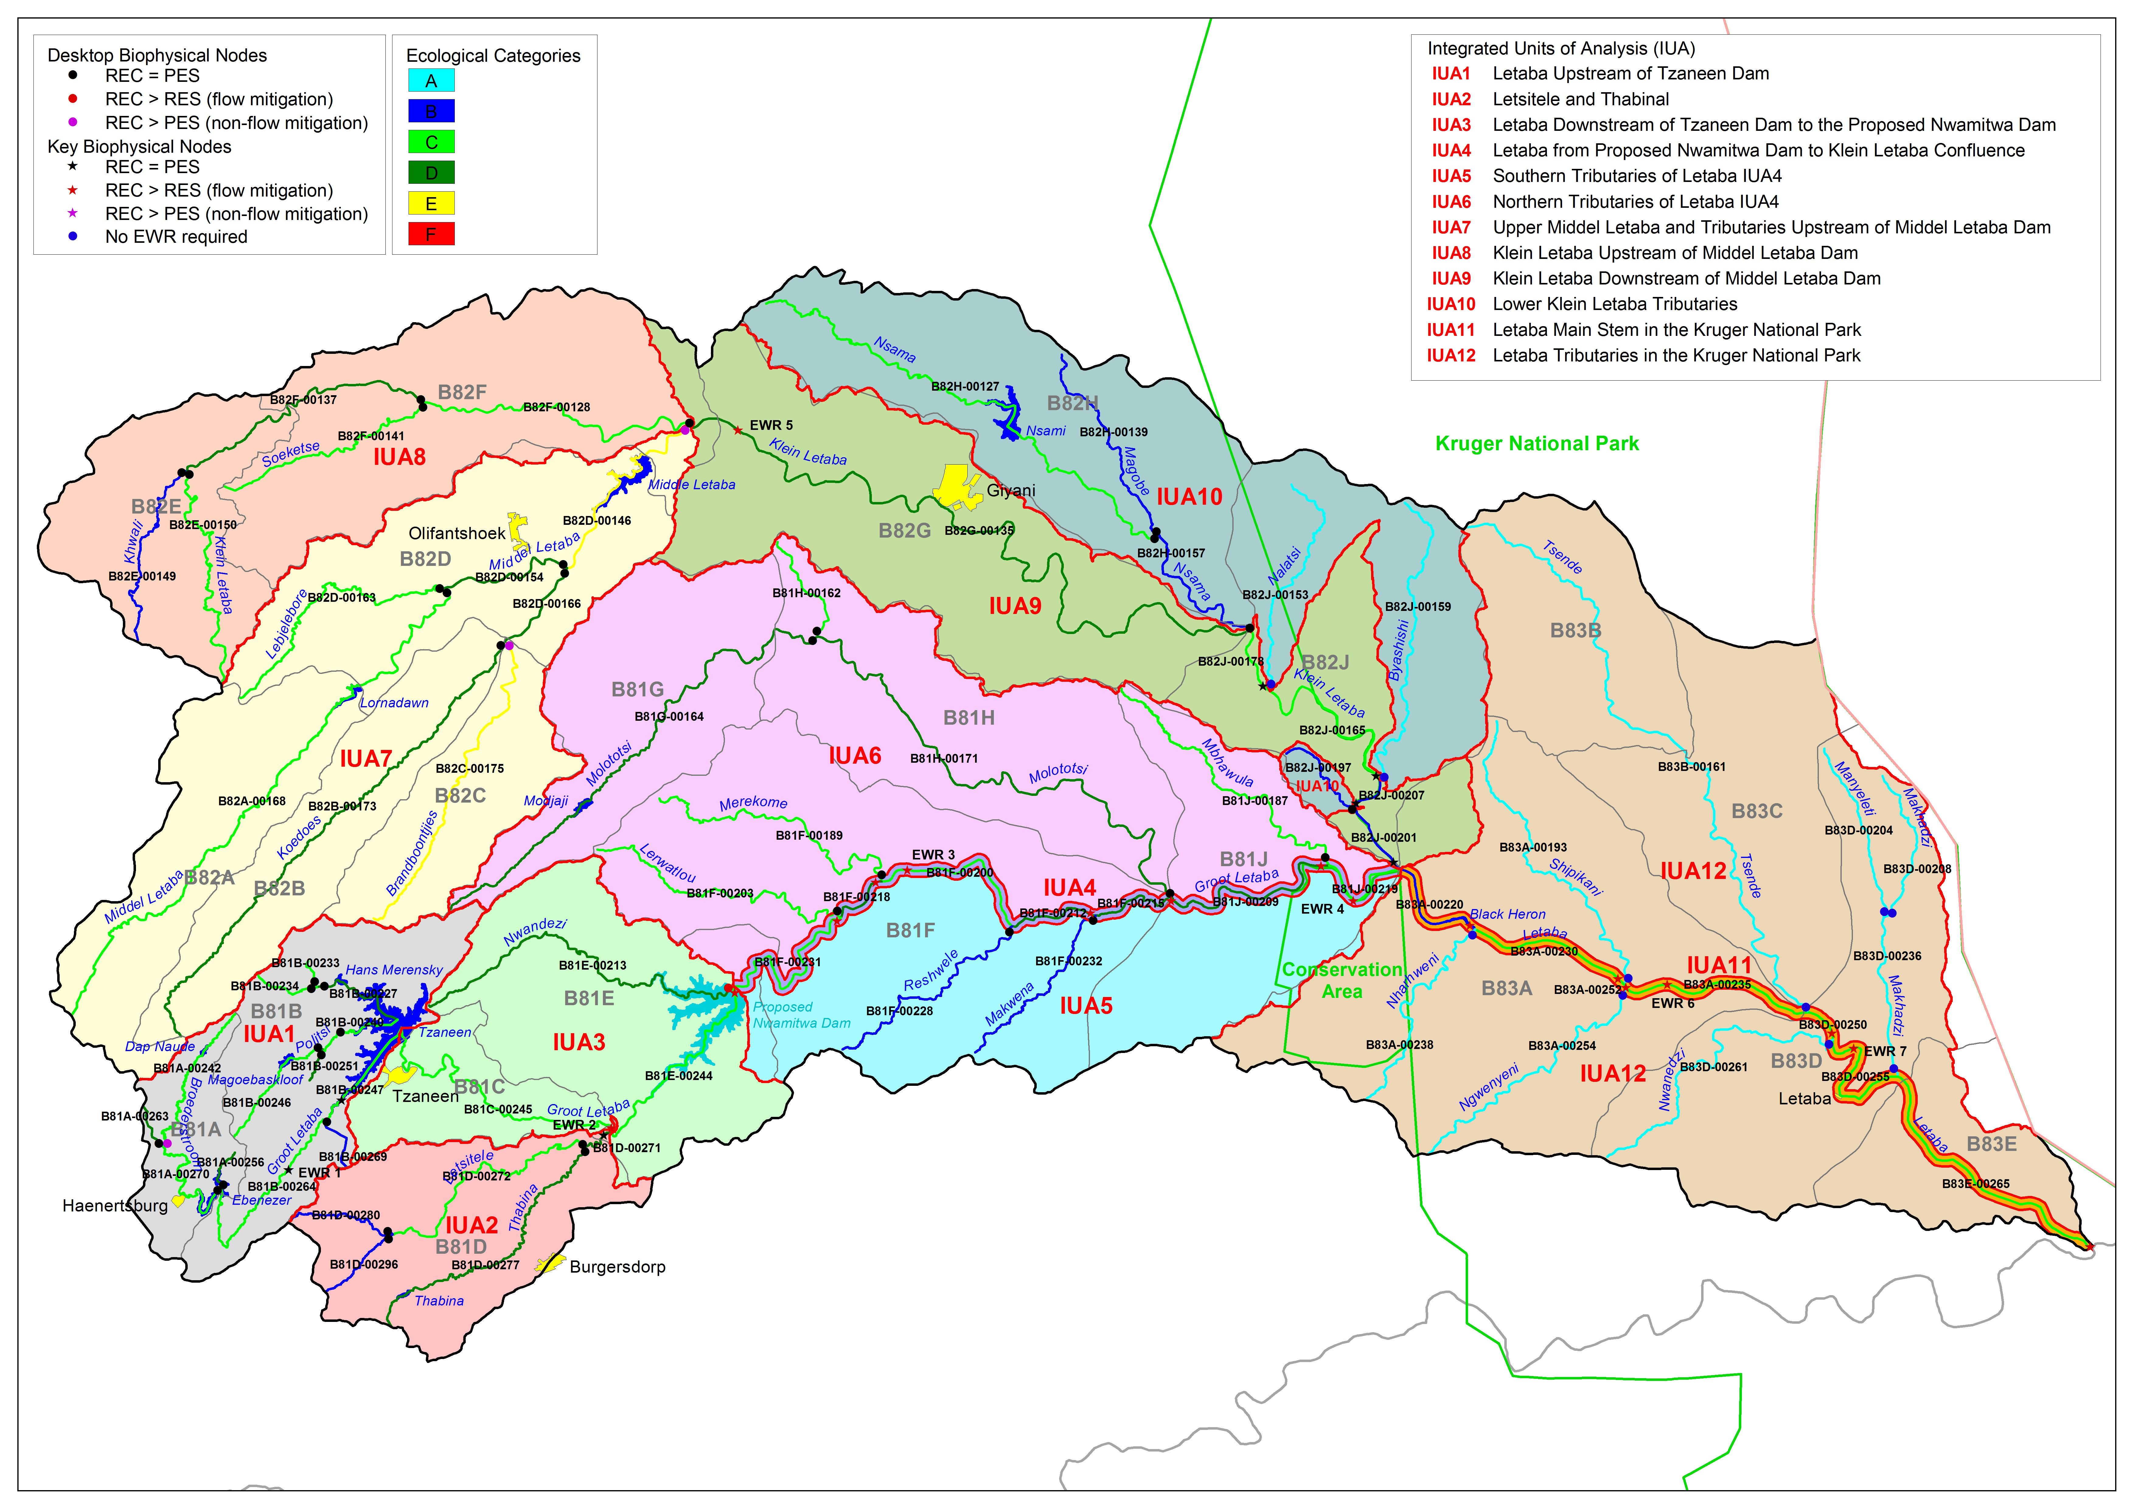
EWR 5
EWR 3
EWR 4
EWR 6
EWR 2
EWR 7
EWR 1
EWR = Ecological Water Requirement (site)
Notes:
Catchment of the Letaba River System.
In the west large dams (Ebenezer, Tzaneen, Middel Letaba dams) make
water available for irrigation and domestic/urban use, in the east the Kruger National Park
is an important protection area.
Approved water resource developments are: Transfer pipeline from Nandoni Dam to the Giyani area, Raising of Tzaneen Dam, Nwamitwa Dam, groundwater schemes and related water treatment and conveyance infrastructure.
Possible future projects are:
Resource development on the Klein Letaba – linked to the Middel Letaba – Nsami system.
Exchange or supply source, some supply schemes currently receiving water from Letaba will be supplied from Nandoni Dam.
Groundwater – but need to be limited to maintain baseflow in the rivers.
The elements used for classification and RQO determination are:
12 IUAs (Management Class set for each IUA),
62 biophysical nodes, including;
7 Ecological Water Requirement Sites
Each biophysical node represents a resource unit - river reach.
Groundwater resources were assessed in an integrated manner with
A Management Class was determined for each IUA.
Based on the selected Ecological Categories of the biophysical nodes.

Slide 13
Aspects considered in Class determination
Ecological Water Requirements:
  Detailed determination at 24 nodes of which 7 are EWR sites (key nodes).
  Desktop determination at 38 nodes.
User water requirements (How much water is used?)
  Quantity and quality
Hydrological assessment (How much water is available?)
  Detail study (groundwater- surface water interaction)
Socio-economic activities relying on water:
  GDP, Jobs (irrigation, urban, light industry, informal)
  EcoSystem Services (use of water in the rivers)
Notes:
Bullet 1: The ecological aspects include:
Fish, invertebrates, vegetation, water quality.
In river and riparian and wetlands.
Importance was determined, also considering protected areas.
Hot spot areas were identified and priority Resource Units defined for setting RQOs
Bullet 2: Validation study was preformed to determine existing water use (groundwater and surface water)
Forestry, alien invasive plants, irrigation, water for domestic/urban use, evaporation from dams.
Bullet 3: Detail hydrological study was carried out as part of the Reconciliation Strategy Study, for the first time
the groundwater-surface water interaction was build into the simulation models and balances.
(Implication of groundwater abstraction of the base flow in the rivers)
Calibration was carried out against all reliable streamflow gauges.
Bullet 4: The socio-economic benefits derived from the water abstracted were defined by:
Gross Domestic Product dependant on water use (Direct and Indirect activities were taken into consideration)
Light industry associated with urban development and relying on the availability of water was included.
The number of employment opportunities (jobs) as it related to water use was considered.
Informal economic activities were estimated and accounted in the analysis.

Slide 14

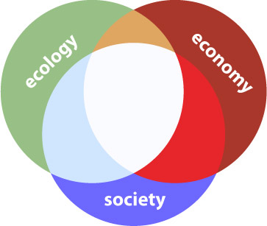
Catchment Analysis
Catchment Resource Availability
Ecological
Water Requirements
Socio-Economic
Water Requirements
Protection
Use
Management Class
(Decision)
Notes:
Detail high resolution network model was setup to asses the water balance at each node.
This was used to asses the implication of alternative scenarios.
(How much is abstracted and what remains in the river for each scenario?)

Slide 15
What are scenarios?
Scenarios, in context of water resource management and planning are plausible definitions (settings) of all the factors (variables) that influence the water balance and water quality in a catchment and the system as a whole.

Slide 16
What are scenarios used for?
Different levels of water use and protection are evaluated with the aim to find a balanced scenario
Water Resource Classification is the process to evaluate and recommend what that balance scenario entails
Notes:
There were a total of 18 Scenarios considered and 6 were presented to the PSC in April.

Slide 17
Management Class Selection Process
Weighed up the level of ecological protection against the socio-economic benefits from water use.
Scenario analysis (4 pillars):
  Ecological status/health rating – relative to the desired ecological conditions
  Ecosystem Services, rated relative to existing services
  Economic activity (GDP in Rand)
  Employment (number of jobs supported)

Slide 18
Overall
Rating
2
1.0
2.0
3.0
Notes:
There were 18 alternatives scenarios considered, 6 were selected for discussion with the PSC.
The process involved quantifying ratings for the 4 pillars (see headings).
Then annotate the different scenarios in and explain them.
Annotate the overall rating.
Finally annotate the selected scenario – this was then what the Manage Classes was based on.

Slide 19
Recommended Scenario
Relevant Water Resource Developments:
  Tzaneen Dam raising, Nwamitwa Dam, Groundwater use within limits, development on Klein Letaba River.
  Improve assurance of supply and allow additional water for domestic/urban use.
Ecological Water Requirements (main stem):
  Maintain low flows to maintain the Present Ecological State.
  Groot Letaba: Release part of the high flow requirements (Jan, Feb & March)
Tributaries unaffected by scenario - REC.

Slide 20
Recommended IUA Management Classes
Integrated Unit of Analysis | Management Classes (current condition) | Management Classes (recommended scenario)
1 | II | II
2 | III | III
3 | III | III
4 | II | II
5 | I | I
6 | III | III
7 | III * | III
8 | II | II
9 | II | III
10 | I | I
11 | II | II
12 | I | I
* Present conditions below Class III criteria

Slide 21
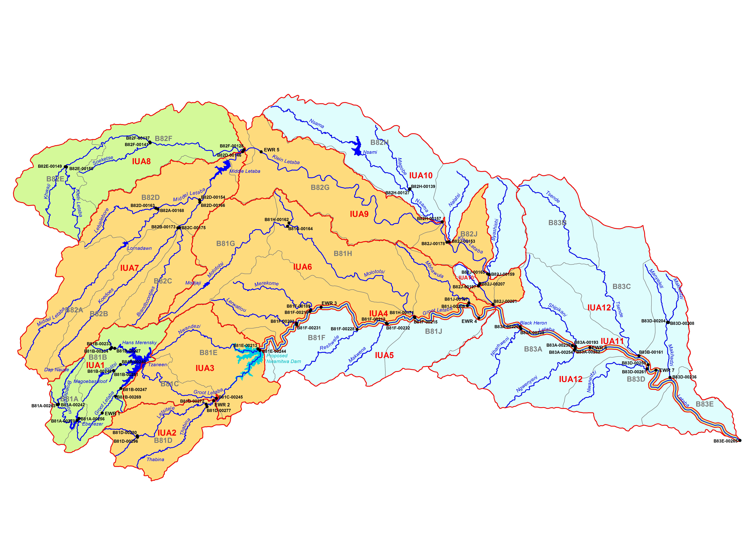
Management Classes
MC I
MC II
MC III
IUA 4 (Letaba – Nwamitwa to Klein Letaba)
IUA 11 (Letaba in KNP)
MC II

Slide 22
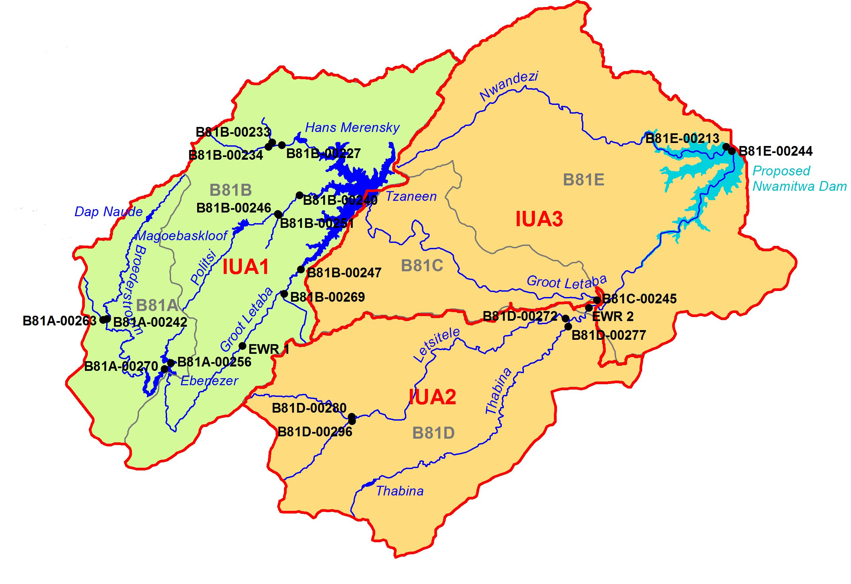
Upstream of proposed Nwamitwa Dam Dam
MC III
IUA 1: Letaba US of Tzaneen Dam
Forestry, pumping from river & groundwater, various dams.
Ecology is mostly MODERATELY modified.
Scenario will maintain the target state (current) and not impact negatively on the user.
MC II
IUA 2: Letsitele and Thabina
Agriculture (formal & informal) with pumping of river and dams. Small dams, forestry. Dense population in lower reaches.
Upper areas in GOOD ecological condition, lower areas in MODERATE to mostly POOR condition.
Scenario will maintain the target state (current) and not impact negatively on any user.
IUA 3: Letaba DS of Tzaneen to Nwamitwa
Formal irrigation, supplied from Tzaneen Dam and stored in various dams.
LARGELY modified ecological condition.
Scenario will maintain the target state (current) and not impact negatively on any user.
Notes:
IUA1: Ebenezer Dam, Haenertsburg. IUA 3: Tzaneen,
IUA2:

Slide 23
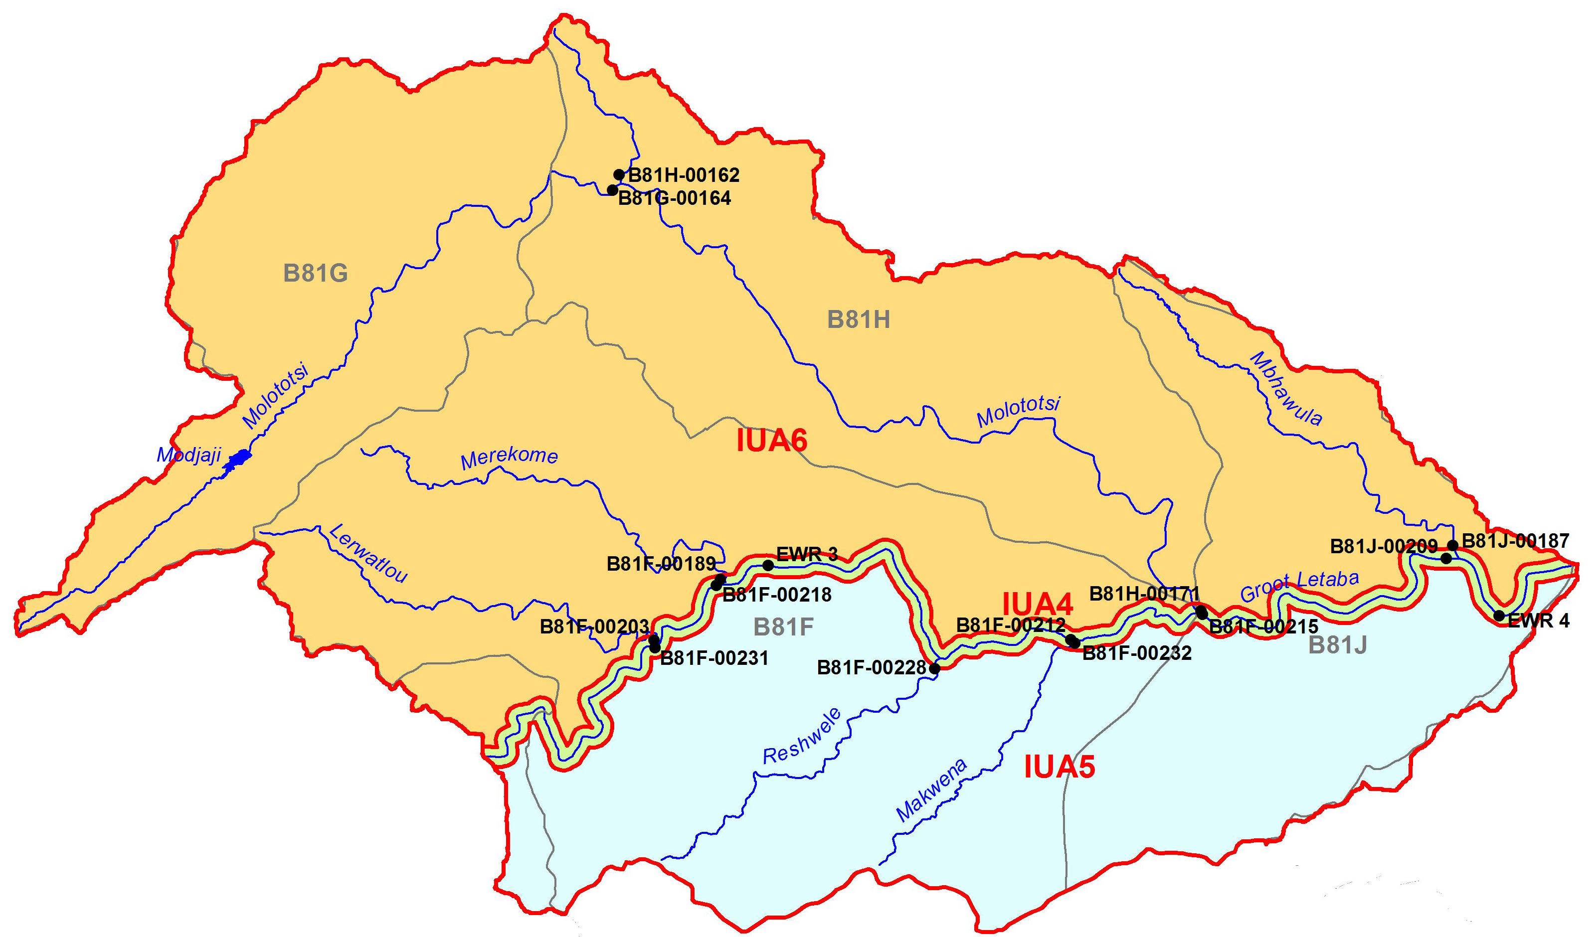
Downstream of proposed Nwamitwa Dam to Klein Letaba
IUA 6: Northern tribs to Letaba
3 short very dry rivers and seasonal Molototsi.
Water supply to urban/domestic, irrigation, subsistence agriculture.
Ecology is LARGELY modified.
Scenario will maintain the target state (target) and not impact negatively on the user.
MC III
MC II
MC I
IUA 4: Letaba – Nwamitwa to Klein Letaba
Largely irrigation, some subsistence use, nature reserves
Ecological mostly MODERATE but HIGH importance – need IMPROVEMENT.
Scenario will maintain and slightly improve the current state but not achieve the required ecological improvement.
IUA 5: Southern tribs to Letaba
Dry rivers, mostly in private nature reserves (Ndzalema).
Good ecological condition and the target would be to maintain this condition.
Scenario will maintain the target state and not impact negatively on the user.
Notes:
IUA 6
IUA 4 Hans Merensky Nature Reserve and Die Eiland tourism area. IUA 5: Ndzalema Nature Reserve and others

Slide 24
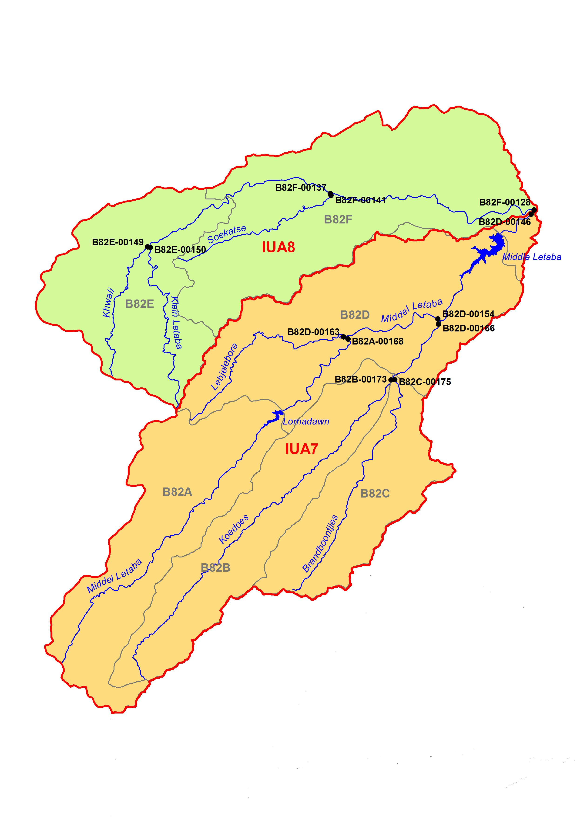
MC Upper Klein & Middle Letaba
IUA 8: Klein Letaba US of confl with Middle Letaba
Commercial farming and rural areas
Mostly MODERATELY modified and in better condition (Ecology).
Scenario will maintain the target (current) state and not impact negatively on the user.
MC II
MC III
IUA 7 (Middle Letaba & tribs US of Middle Letaba Dam)
Extensive formal agriculture, many farm dams,
Ecology mostly LARGELY modified
Two sections in a bad condition (CRITICALLY MODIFIED) (inundation and water quality). (Brandboontjies and section of Middle Letaba)
Currently, such that IUA does not comply to MC III criteria.
Difficult to improve manage rest of IUA in a MC III.
Scenario does not impact on IUA or current economic activities.
Notes:
IUA 8:
IUA 7: ZZ7??

Slide 25
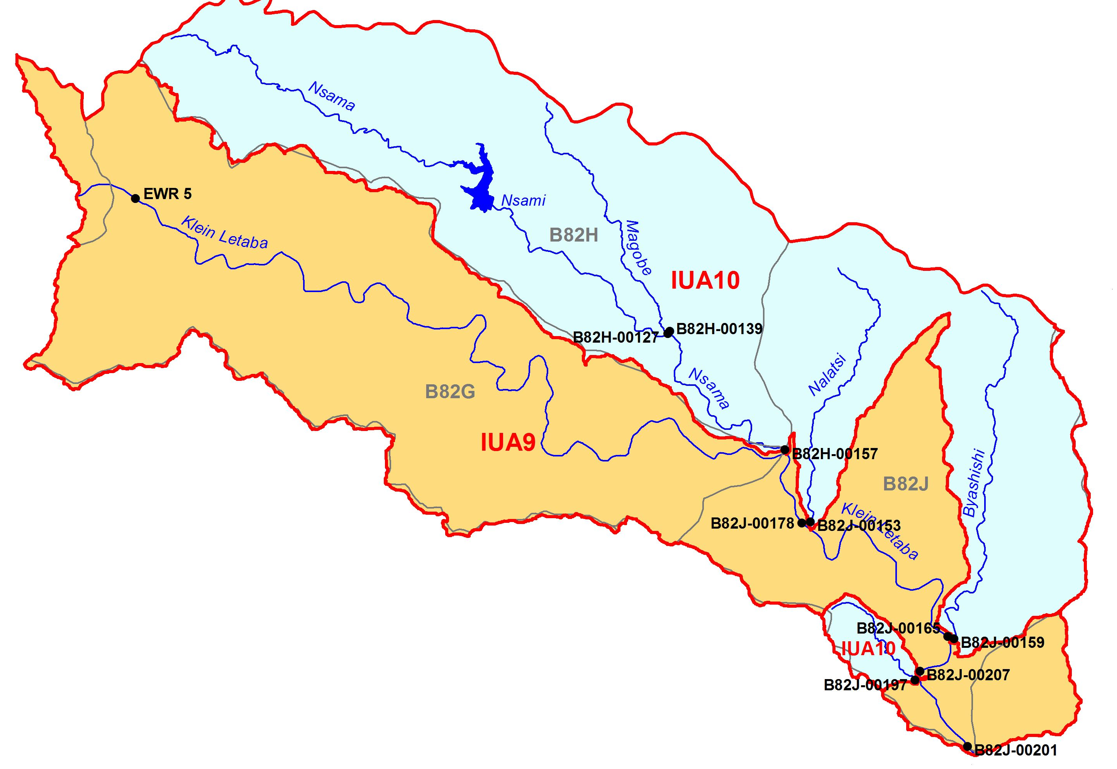
MC Klein Letaba DS of Middle Letaba Dam & tribs
IUA 10 (Lower Klein Letaba Tributaries)
Very dry tribs regulated by Nsami Dam. Urban and irrigation.
Ecology mostly in GOOD condtion
Maintaining this GOOD condition as target will not impact negatively on the user.
IUA 9 (Klein Letaba DS from confl with Middle Letaba)
Regulated by Middle Letaba Dam.
Ecology mostly MODERATELY modified
As scenario includes a new dam, there will be some impact (but minor if managed to provide EWRs) on the ecology.
There will be some increase in economics due to possible further resource development (Crystalfontein Dam)
MC I
MC III
Notes:
IUA 9: Gyani
IUA 10

Slide 26
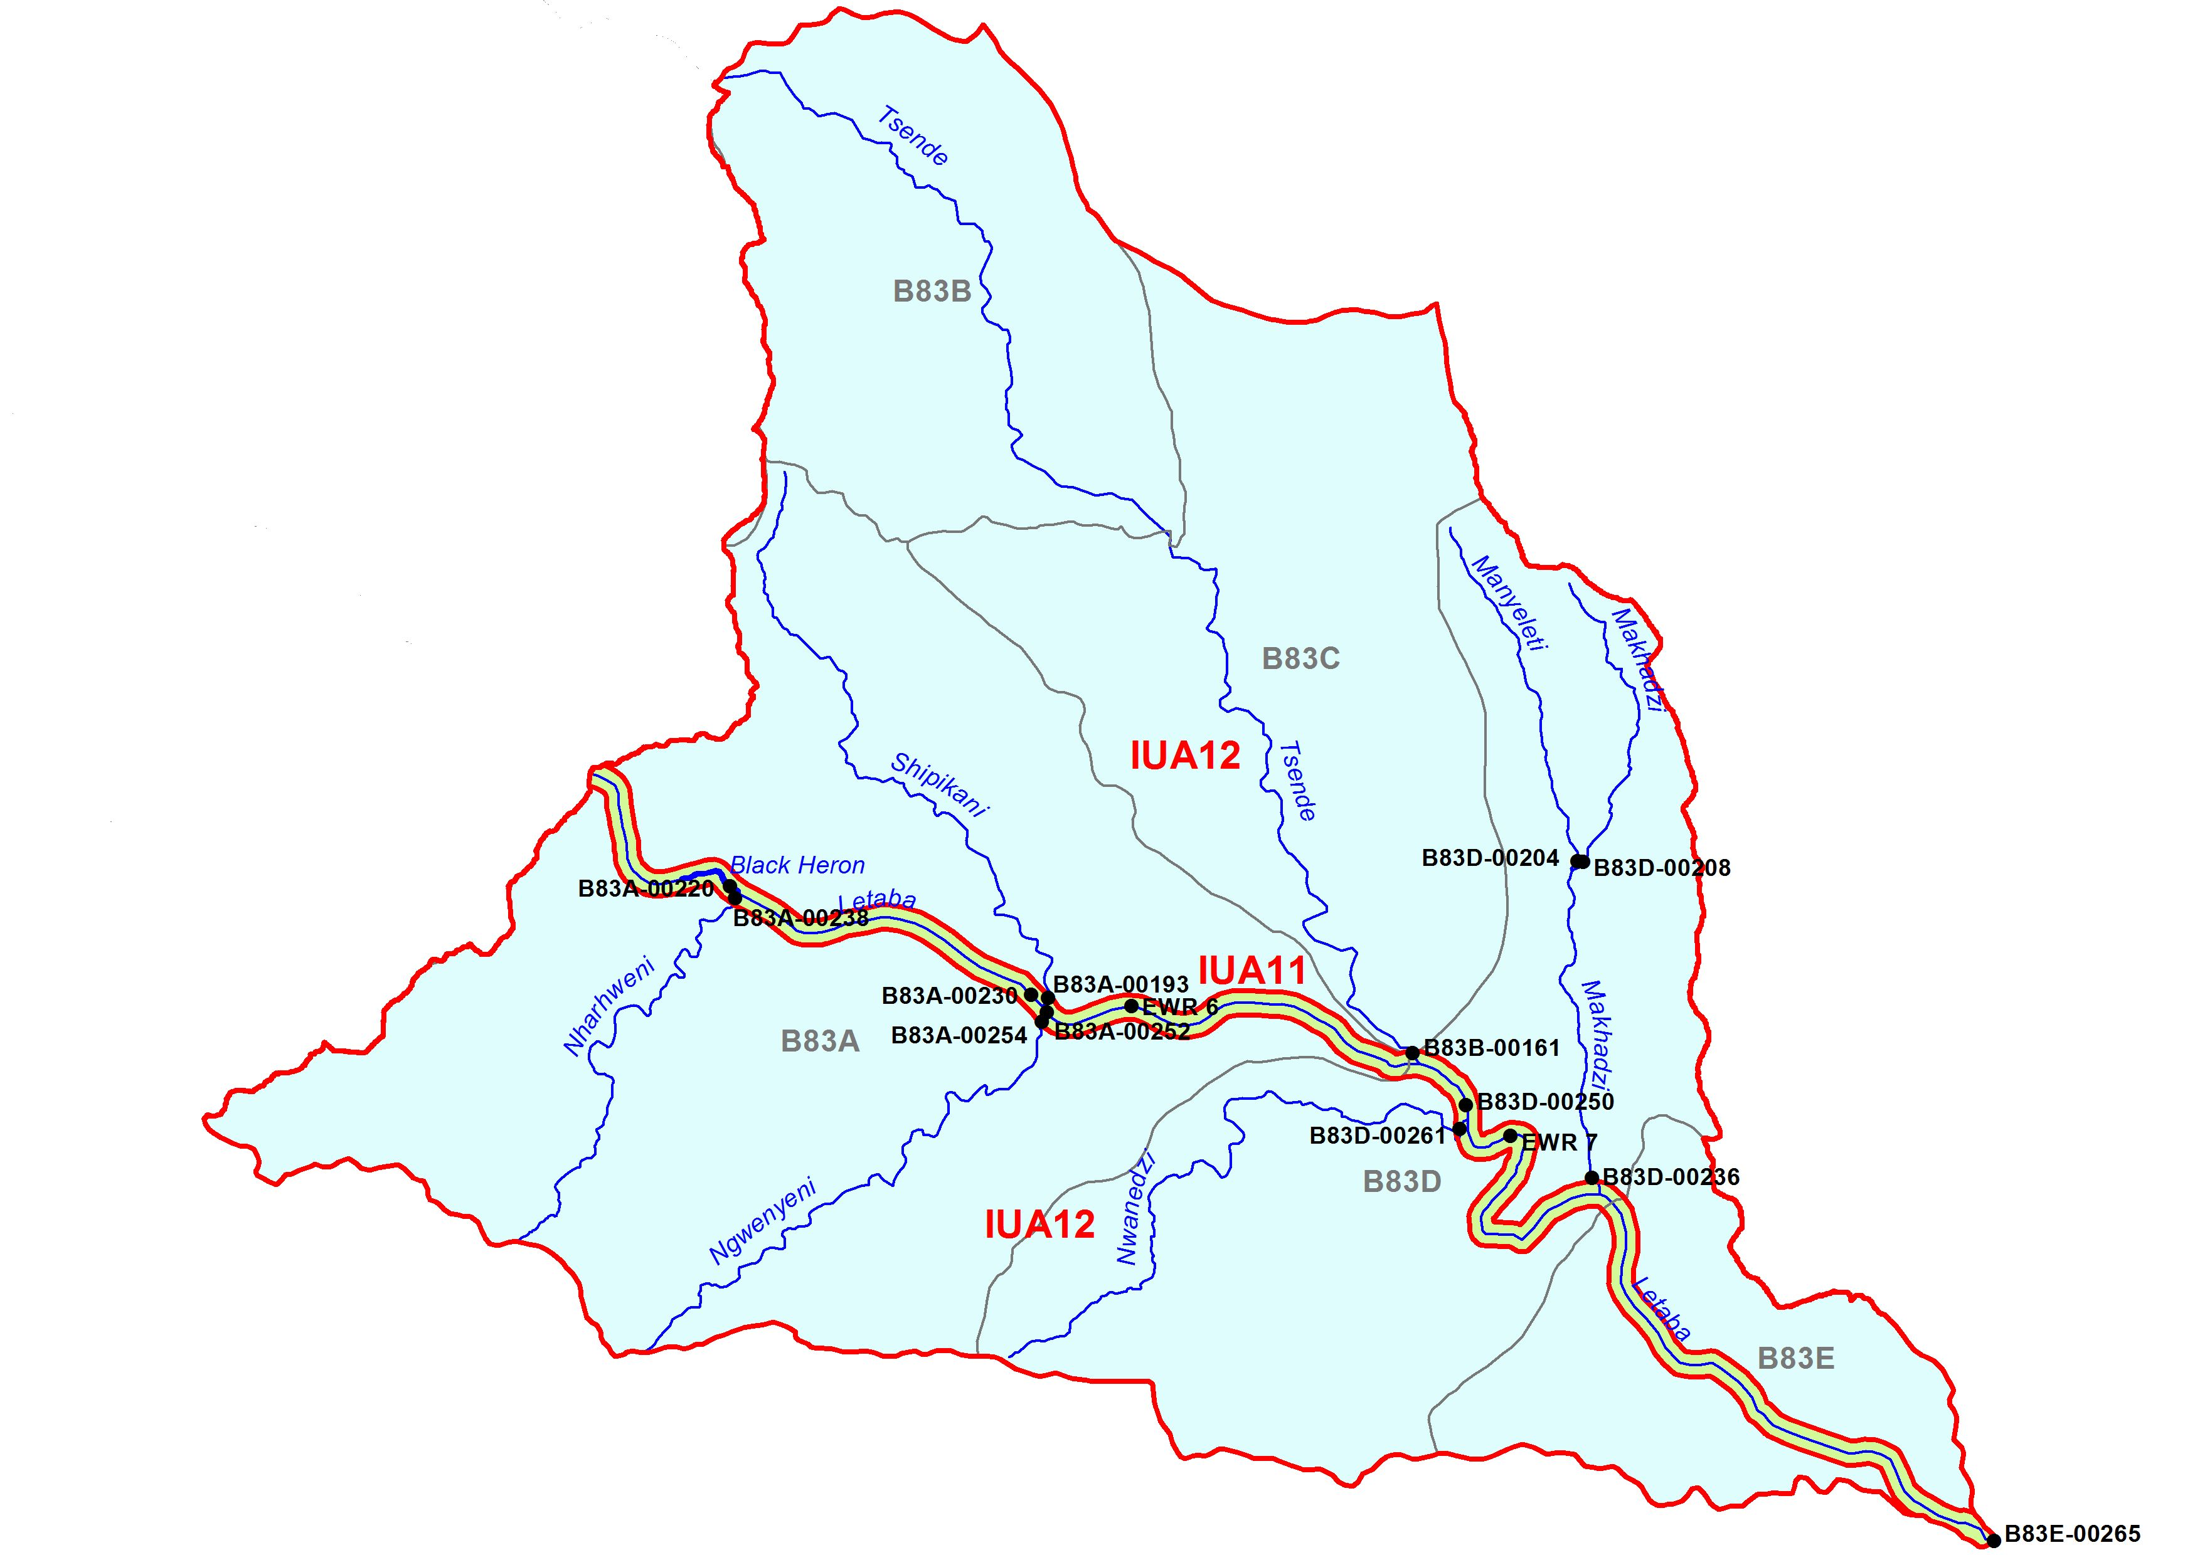
MC IN KRUGER NATIONAL PARK
IUA 11 (Letaba in KNP)
Impacts relate to upstream activities - flow changes are key.
Ecology mostly MODERATELY modified. VERY IMPORTANT as in KNP and should improve.
Improvement not possible and although current state overall will be maintained, there will be a degradation in condition for fish and bugs with this scenario.
MC II
MC I
IUA 12 (Letaba tribs in KNP)
.Rivers completely in KNP. No impact. All EXELLENT condition.
Sc no impact and MC I allocated to IUA

Slide 27
What are Resource Quality Objectives?
In essence:
RQOs are the objectives or goals which can be measured or monitored to determine whether the Management Class is being achieved.
I.e.
RQOs are set for the Management Class

Slide 28
Where do you set the RQOs?
RQOs can be set for each Resource Unit (a reach of river).
Resource Units must be prioritised, high priority Resource Units must have detailed RQOs.
Three Resource Unit priority level of RQOs have been determined.
Different levels of RQOs are set for each priority level

Slide 29
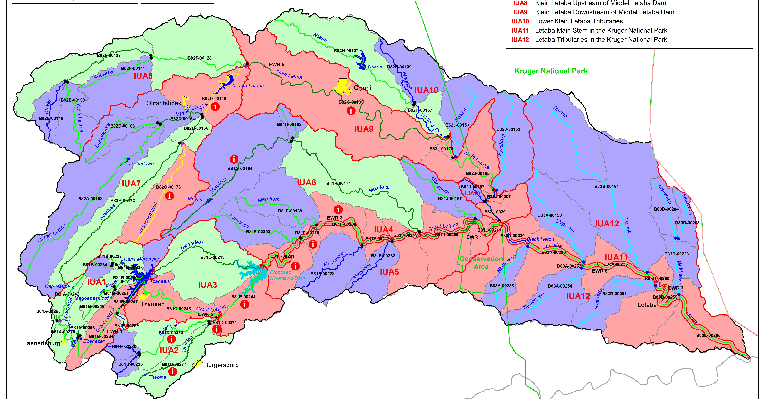
Priority Resource Units
High priority (3)
Moderate priority (2)
Low priority (1)

Slide 30
For which components/indicators RQOs set?
Quantity, pattern and timing of instream flow (hydrology).
Water quality
Characteristics and condition of riparian habitat and biota
Characteristics and condition of instream habitat and biota

Slide 31
PRIORITY INDICATOR FOR SUBCOMPONENTS
Examples of subcomponents indicator
IUA | Node name | Component indicator
IUA 1 | B81B-00246 | 1. Rip veg 2. Instream biota
IUA 10 | B82H-00127 | 1. Rip veg
IUA 8 | B82F-00137 | Rip veg 1. Water quality 2. Instream biota
Riparian EC
Aerial cover
% aliens
Fish EC
Sp
Sp richness
FROC
Nutrient levels
Conductivity
Toxics

Slide 32
HYDROLOGICAL RQOs
Flow regime associated with the Management Class:
  Defines the flow needed at different times of the year.
  In low rainfall periods the flow needed is also low.
  When rainfall is high the low required in high.
  (Hydrological RQOs is defined by quantity and frequency for each month of the year)

Slide 33
WATER QUALITY RQOs
These describe objectives for water quality for the following (description and/or numbers):
  Ecological requirements
  Domestic Use; assumes primary treatment
  Agriculture: Stock Watering
  Agriculture: Irrigation
  Industrial: Category 3
  Recreation: Full Contact
Present the numbers as
  95th percentile for toxics + salts
  50th percentile for nutrients due to greater variability with flow
Notes:
Category 3 industrial use:

Slide 34
BIOTA AND HABITAT RQOs
These describe the habitat and biota which you will find in the river if the Management Class is implimented.
For low priority RUs: Provide an overall target Ecological Category.
For moderate priority RUs: Provide an overall target, but more detail for indicators.
For high priority RUS – those RUs with key nodes: Provide a target Ecological Category for each component and a description and linked numbers.

Slide 35
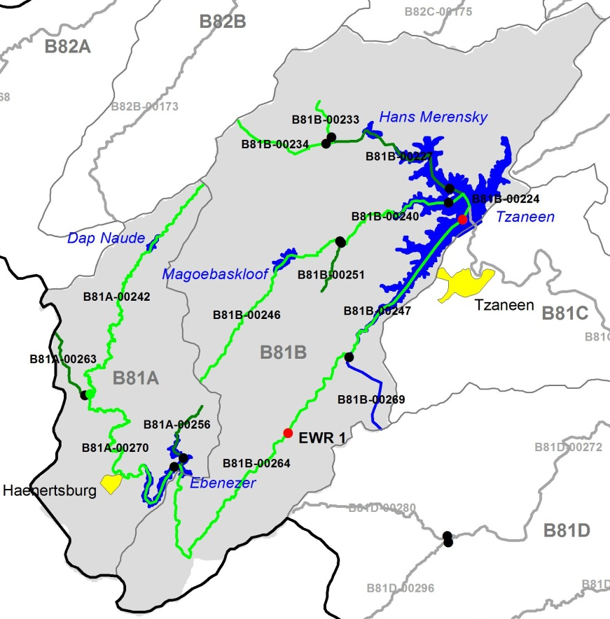
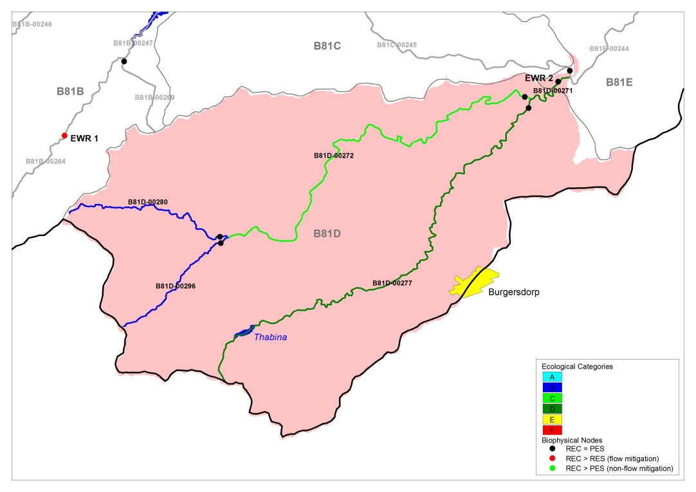
IUA 1, RU EWR 1 (LETABA)
Biota, Habitat, WQ RQOs
Comp | Target | Narrative RQO
Geomorph | C/D | Maintain the geomorphological structure
Fish | C | Do not reduce current 22 sp. Indicator of fast flowing habitats is the stargazer.
Inverts | C | Maintain the current population and important stones in current and marginal vegetation habitat.
Vegetation | C | Keep aliens in check. Maintain viable populations of matumi, leadwood, apple leaf
Water quality | B | Ensure that nutrient levels are within Acceptable limits

Slide 36
IUA 2, RU EWR 2 (LETSITELE)
Biota, Habitat, WQ RQOs
Comp | Target | Narrative RQO
Geomorph | D | Maintain geomorphological structure
Fish | C/D | Do not reduce current 24 sp. Indicator of fast flowing habitats is the stargazer.
Inverts | C | Community representative of small foothill stream assemblage. Maintain good stones in current and marginal veg habitat
Vegetation | D | Keep aliens in check. Maintain healthy populations of matumi, leadwood, apple leaf
Water Quality | C | Ensure that nutrient levels are Tolerable, electrical conductivity (salt) levels + toxics are Ideal, faecal coliform + E.coli targets are met for recreational (full contact) use

Slide 37
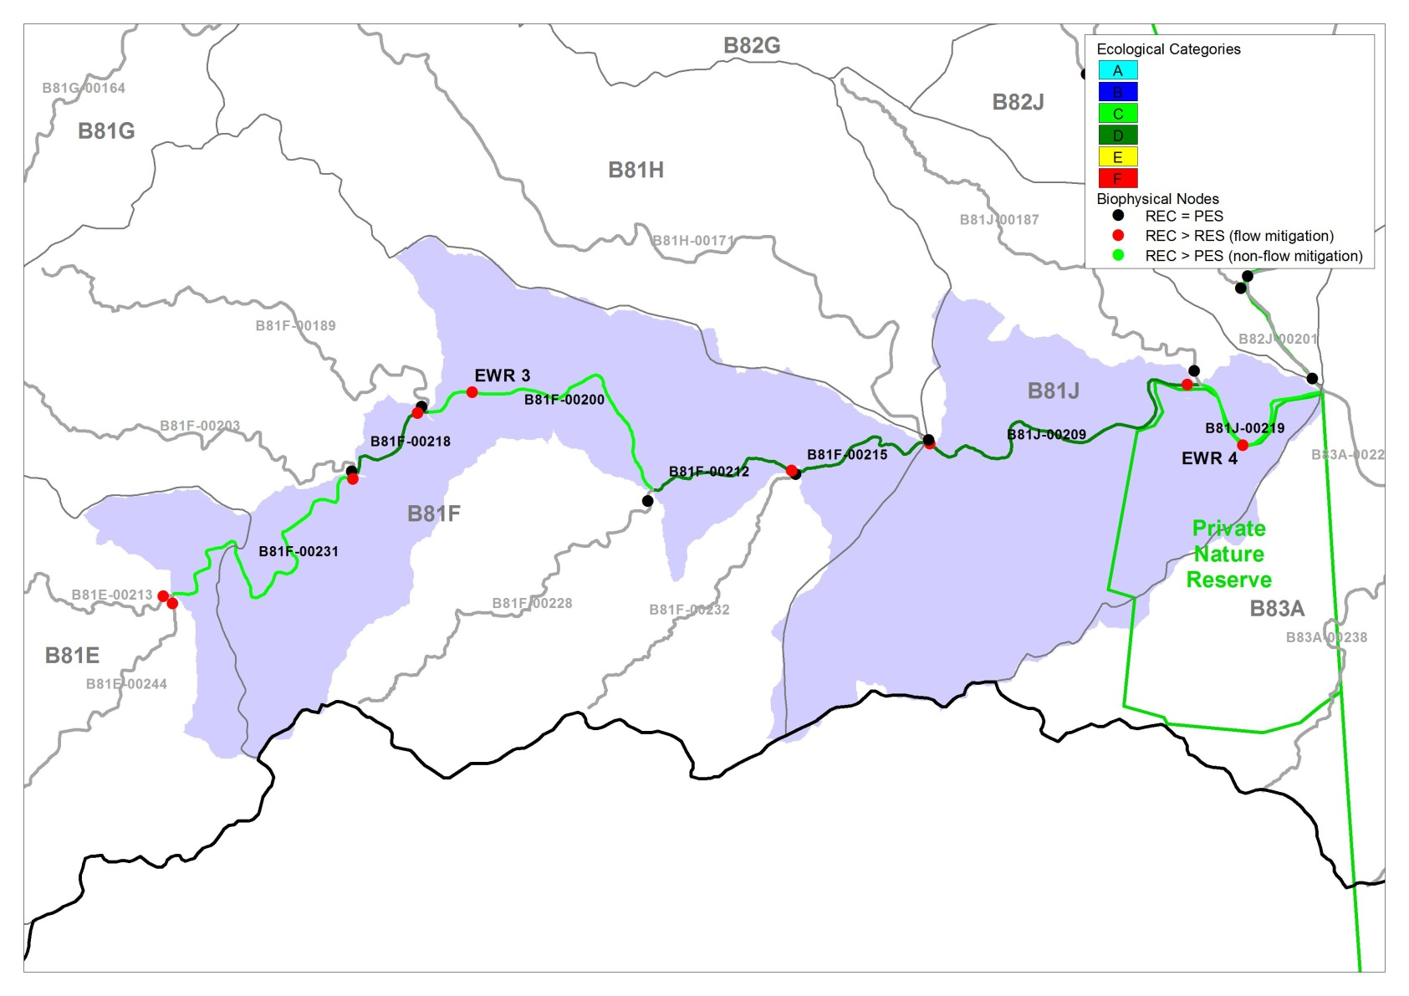
IUA 3 & 4, RU EWR 3 (LETABA)
Biota, Habitat, WQ RQOs
Comp | Target | Narrative RQO
Geomorph | D | Maintain the geomorphological structure
Fish | C | Do not reduce current 30 sp. Indicator of fast flowing habitats is the Shortspine suckermouth.
Inverts | C | Community representative of Lowveld river in the middle with seasonal traits. Maintain the C diversity and integrity.
Vegetation | C | Maintain C. Keep aliens in check. Maintain viable populations of matumi, leadwood, apple leaf
Water quality | B | Ensure that nutrient levels are Acceptable, electrical conductivity (salt) levels, pH + toxics are Ideal, faecal coliform + E. coli targets are met for recreational (full contact) use

Slide 38
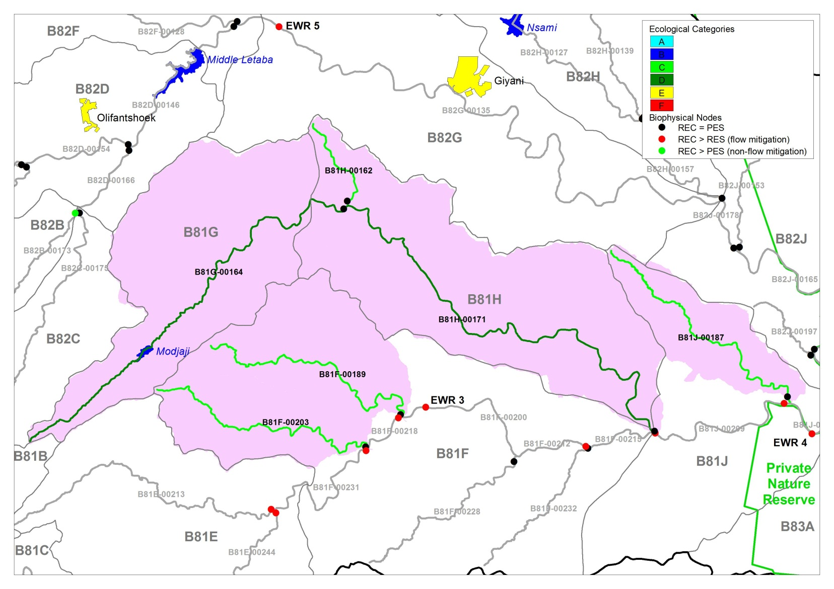
IUA 6: Northern tribs to Letaba: Low & moderate priority RUs: Flow, habitat and biota RQOs
Comp | Narrative RQO
Riparian veg | Vegetative cover along riparian zone banks should be maintained in order to provide bank stability and prevent erosion.
Water quality | Nutrients levels must be Acceptable. Faecal coliform targets for recreational use must be met.

Slide 39
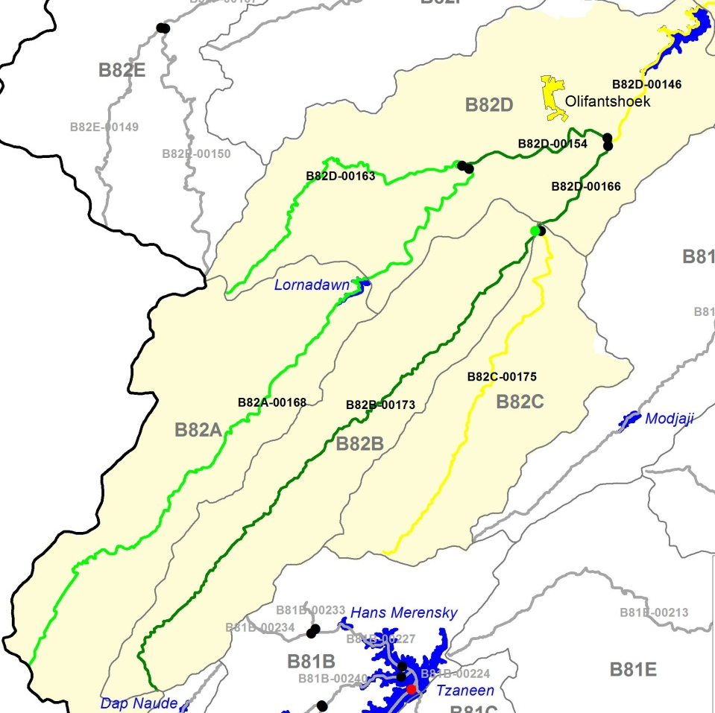
IUA 7, UPPER MIDDLE LETABA + TRIBS
B82C-00175, Brandboontjies: WQ RQOs
RQO
Ensure that nutrient levels are Acceptable, toxics are Ideal and meet faecal coliform and E. coli targets for recreational (full contact) use.

Slide 40
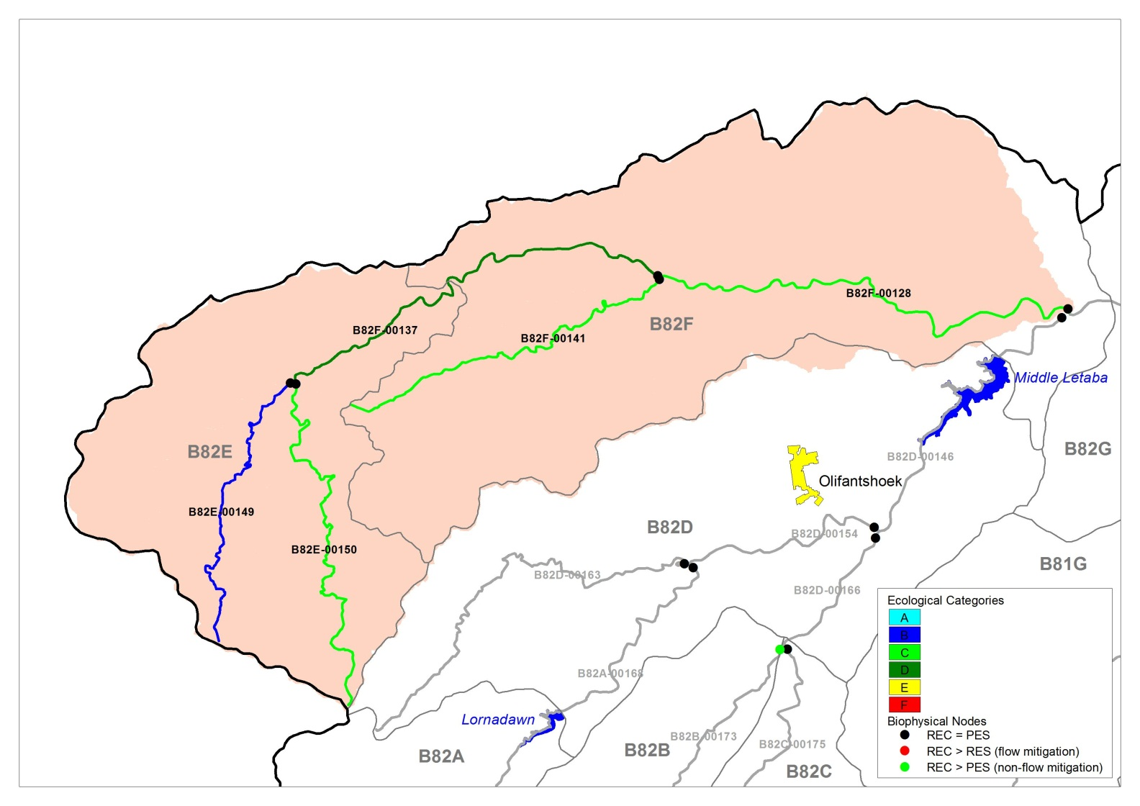
IUA 8: Klein Letaba us from dam: Habitat and biota RQOs
Comp | RQO
Veg | Agriculture should not encroach Riparian zone fragmentation should not increase Vegetation cover on banks must be maintained for bank stability and to prevent erosion.
Fish (B82F-128) | Maintain PES, sp richness, Suitable flow for primary indicators large scale yellowfish

Slide 41
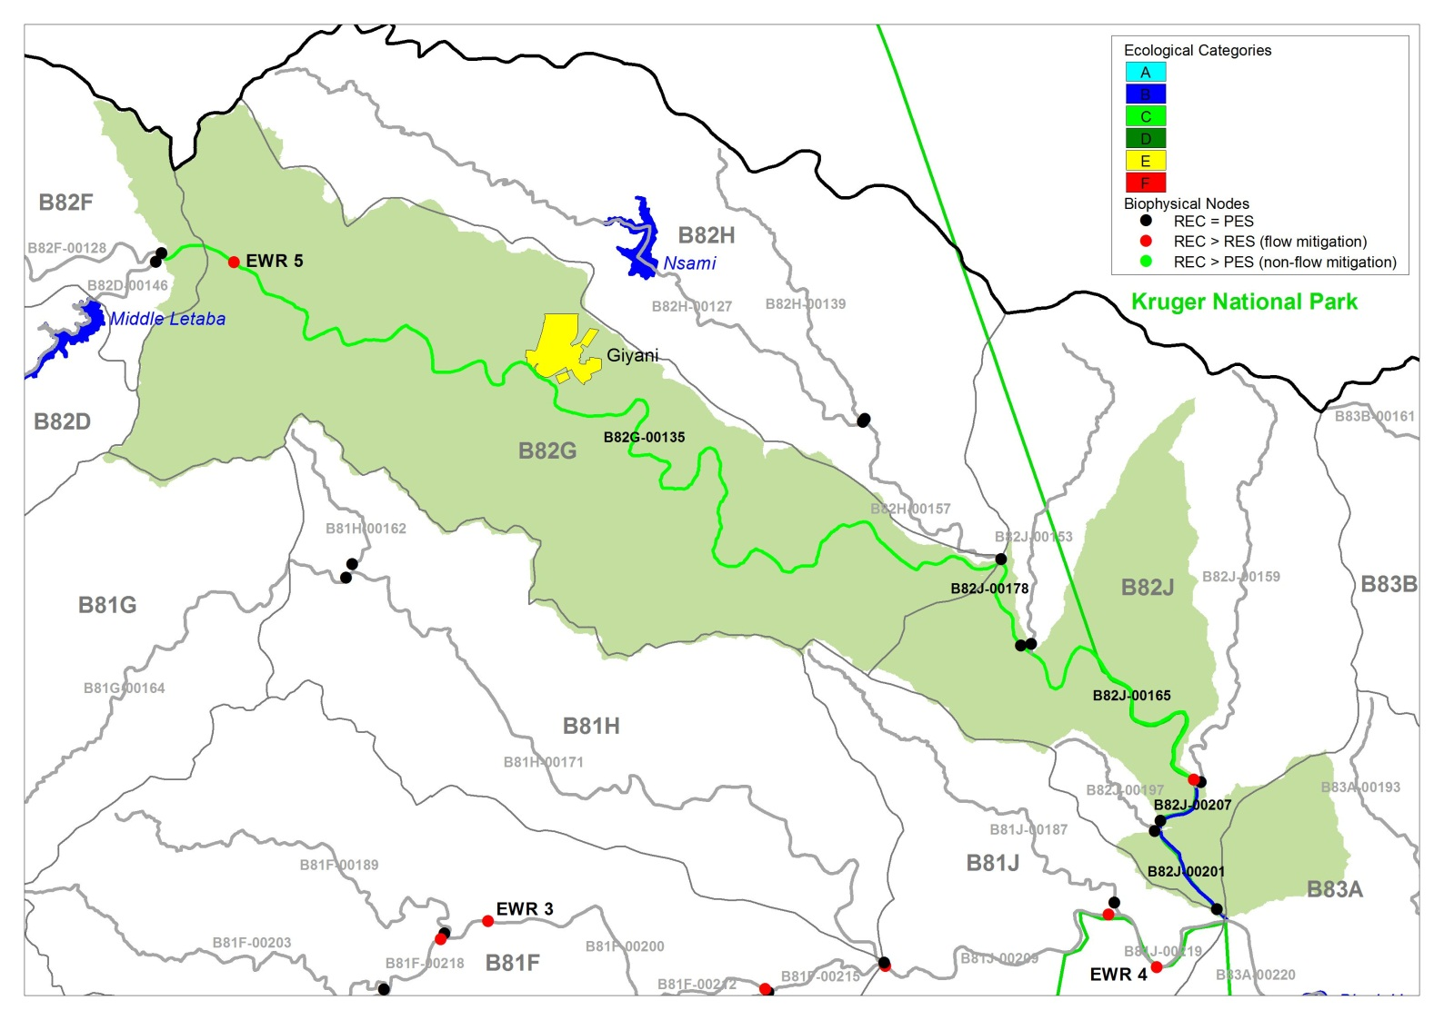
IUA 9, RU EWR 5 (KLEIN LETABA)
Biota, Habitat, WQ RQOs
Comp | Target | Narrative RQO
Geomorph | D | Maintain geomorphological features
Fish | C | Do not reduce current 23 sp. Indicator of fast flowing habitats is the sawfin suckermouth.
Inverts | D | Maintain Lowveld population with strong seasonal characteristics
Veg | C/D | Keep aliens in check. Agricultural activities should not encroach. Maintain viable populations of matumi, leadwood, apple leaf
Water quality | C | Ensure that nutrient and turbidity levels are Acceptable, toxics are Ideal, faecal coliform + E. coli targets are met for recreational (full contact) use.

Slide 42
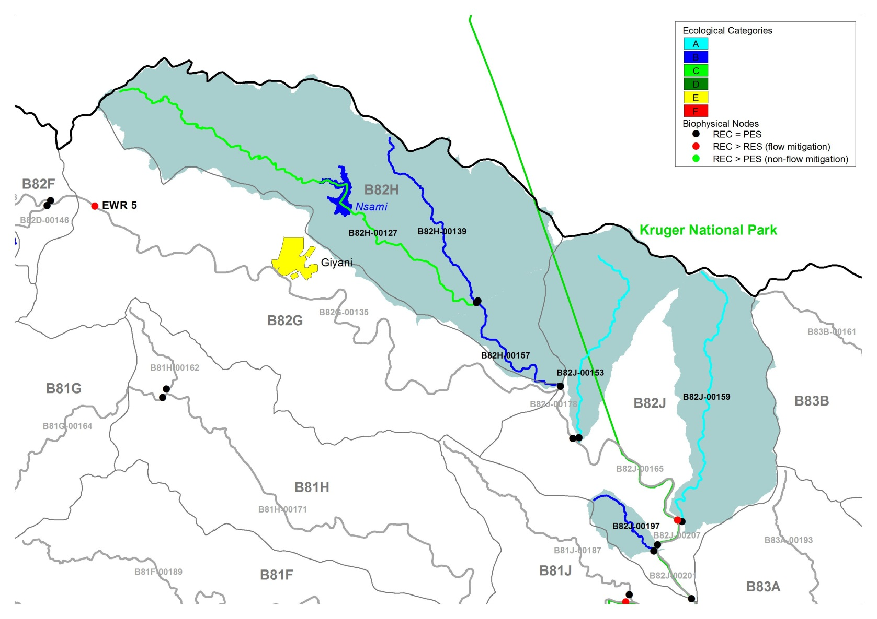
IUA 10: Northern tribs to Letaba: Habitat and biota RQOs
Comp | Narrative RQO
Riparian | Agriculture should not encroach Riparian zone fragmentation should not increase Vegetation cover on banks must be maintained for bank stability and to prevent erosion.

Slide 43
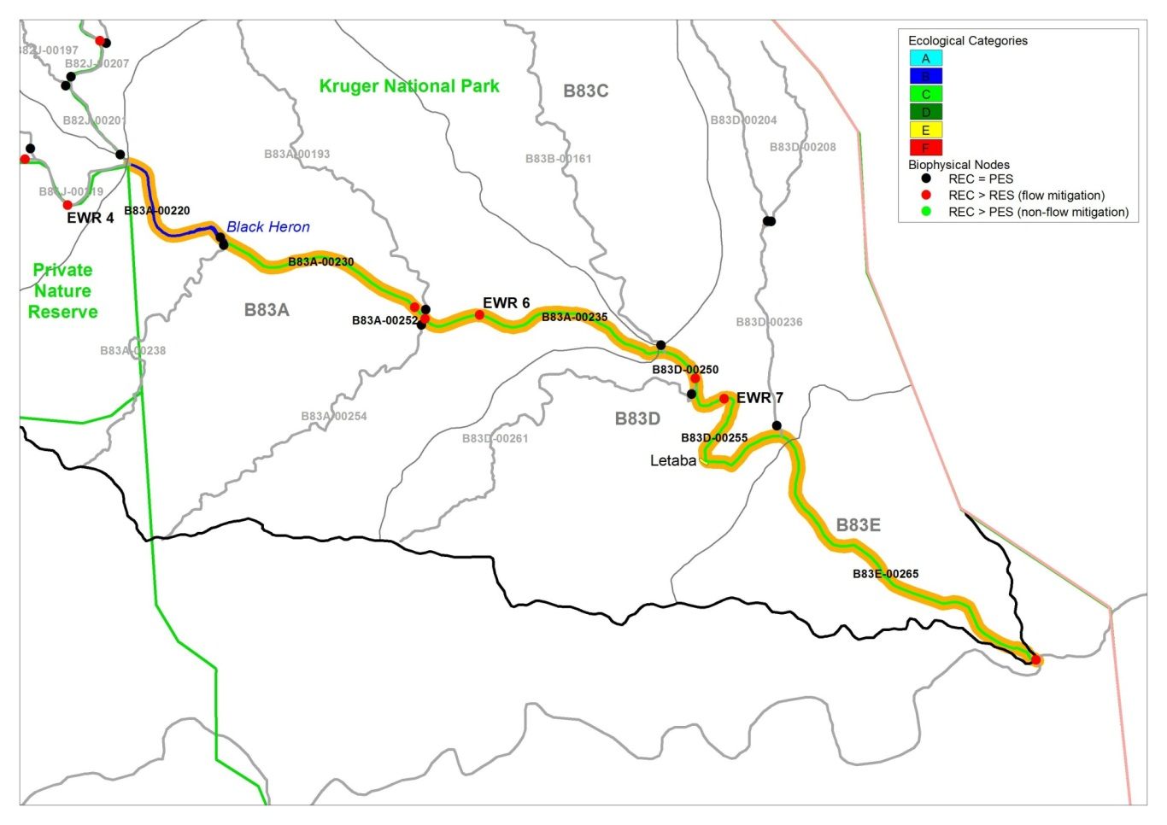
IUA 11, RU EWR 7 (LETABA)
Biota, Habitat, WQ RQOs
Comp | Target | Narrative RQO
Geomorph | C | Maintain the current EC and geomorphological structure
Fish | C/D | Do not reduce current 29 sp. Maintain present FROC for a C and, once Sc 11 is implemented, the FROC for a C/D. Indicator of fast flowing habitats is the sawfin suckermouth and largescale yellowfish.
Inverts | C/D | Community representative of a Lowveld River assemblage. Maintain rare SIC habitat and marg veg.
Veg | C | Maintain C. Keep aliens in check. Maintain viable populations of matumi, leadwood, apple leaf, torch wood
Water quality | B | Ensure that nutrient levels + electrical conductivity (salt) levels are Acceptable, toxics and turbidity are Ideal

Slide 44
Groundwater
Resource Quality Objectives

Slide 45
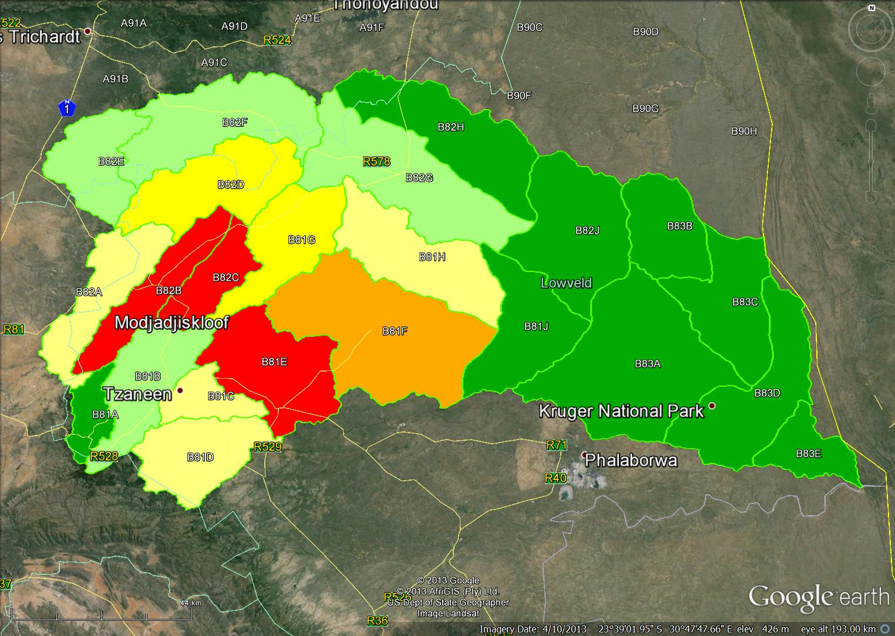
  Groundwater – Present state and recommended
Stress Index : Use/aquifer recharge
A <5% largely unmodified
B 5-20% largely natural
C
C 20-20% largely modified
D
B
E
D
B
D
E
D
D
C
B
D
D
D
C
D
C
C
B
D 40-65% largely modified
D
E 60-95% Seriously modified
F >95% critically modified
D Scenario 10

Slide 46
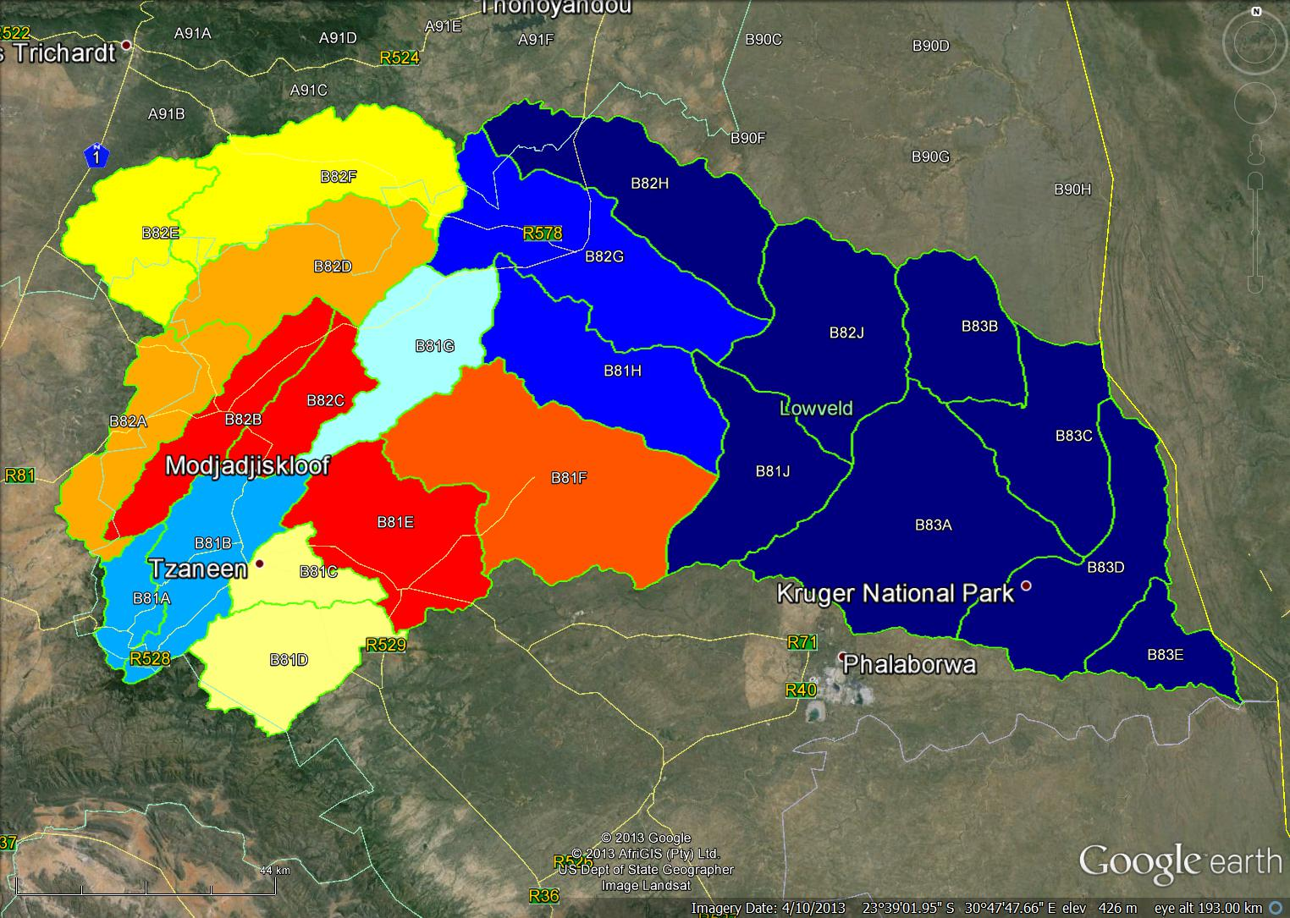
  Groundwater – RQOs
Stress Index
Groundwater contribution to baseflow
Baseflow contribution to MAR

Slide 47
  Groundwater RQOs, Narrative (1 of 2)
 | River | RQO
 | Letaba lower Gr + klein Letaba Nsama | Groundwater is underutilised and can be utilised up to the Harvest Potential with little to no impact on baseflow
 | Klein Letaba Molototsi | Groundwater use is low and can be utilised up to the Harvest Potential with little to no impact on baseflow
 | Molototsi | Groundwater is moderately utilised. Abstraction can be increased up to the Harvest Potential with little or limited impact on baseflow.
 | Gr Letaba | Groundwater is underutilised. Abstraction impacts significantly on baseflow and this region is one of the most significant sources of baseflow in the Letaba system. Hence further investigations as to the impact of abstraction are required before any significant increase takes place.
 | Gr Letaba Letsitele | Groundwater is moderately to heavily utilised. Abstraction impacts significantly on baseflow and this region is one of the most significant sources of baseflow in the Letaba system. Further investigations as to the impact of abstraction are required before any additional abstraction takes place.

Slide 48
  Groundwater RQOs, Narrative (2 of 2)
 | River | RQO
 | Klein Letaba | Groundwater is underutilised. Abstraction impacts significantly on baseflow locally as the region is not a significant source of baseflow to the Letaba system. Abstraction can be increased depending on low flow requirements in the klein Letaba
 | Middle Letaba | Groundwater is moderately utilised. Abstraction impacts significantly on baseflow locally and on inflows into the middle Letaba dam. Increases in abstraction should consider the impacts on the yield of the middle Letaba dam.
 | Groot Letaba | Groundwater is significantly utilised. Abstraction can be marginally increased up to the Harvest Potential with little to no impact on baseflow
 | Koedoes Brandboontjies | Groundwater is over exploited and has resulted in significant reduction in inflows into the Middle Letaba dam. No further groundwater abstraction should be permitted.
 | Groot Letaba | Groundwater is over exploited and has resulted in significant baseflow depletion from the catchment. No further groundwater abstraction should be permitted.

Slide 49
  Specific Groundwater RQOs for IUAs
IUA | Quat | Groundwater narrative RQO | Groundwater numerical RQO
1 | B81A B81B | Groundwater is underutilised. Abstraction impacts significantly on baseflow and this region is one of the most significant sources of baseflow in the Letaba system. Hence further investigations as to the impact of abstraction and SFR activities are required before any significant increase takes place. | Groundwater abstraction can be increased from 2.79 Mm³/a to 10.44 Mm³/a, with a 4.76 Mm³ reduction in baseflow.
2 | B81D | Groundwater is moderately utilised. Abstraction impacts significantly on baseflow and this region is a significant source of baseflow in the Letaba system. Further investigations as to the impact of abstraction and SFR activities are required before any additional abstraction takes place. | Groundwater abstraction can be increased from 4.13 Mm³/a to 7.77 Mm³/a, with a 1.60 Mm³ reduction in baseflow.
Groundwater is underutilised. Abstraction impacts significantly on baseflow and this region is one of the most significant sources of baseflow in the Letaba system. Hence further investigations as to the impact of abstraction and SFR activities are required before any significant increase takes place.

Slide 50
  Specific Groundwater RQOs for IUAs
IUA | Quat | Groundwater narrative RQO | Groundwater numerical RQO
3 | B81C | Groundwater is heavily utilised. Abstraction impacts significantly on baseflow and this region is a significant source of baseflow in the Letaba system. Further investigations as to the impact of abstraction and SFR activities are required before any additional abstraction takes | Groundwater abstraction exceeds the Harvest Potential but not the simulated aquifer recharge. No further abstraction should take place without a review of the harvest potential.
 | B81E | Groundwater is over exploited and has resulted in significant baseflow depletion from the catchment. No further groundwater abstraction should be permitted. | Groundwater abstraction exceeds the Harvest Potential but not the simulated aquifer recharge. No further abstraction should take place without a review of the harvest potential.
Groundwater is underutilised. Abstraction impacts significantly on baseflow and this region is one of the most significant sources of baseflow in the Letaba system. Hence further investigations as to the impact of abstraction and SFR activities are required before any significant increase takes place.

Slide 51
  Specific Groundwater RQOs for IUAs
IUA | Quat | Groundwater narrative RQO | Groundwater numerical RQO
4, 5, 6 | B81F | Groundwater is significantly utilised. Abstraction can be marginally increased up to the Harvest Potential with little to no impact on baseflow | Groundwater abstraction can be increased from 7.94 Mm³/a to 14.40 Mm³/a, with no further reduction in baseflow.
 | B81J | Groundwater is underutilised and can be utilised up to the Harvest Potential with little to no impact on baseflow | Groundwater abstraction can be increased to 6.46 Mm³/a, with a 0.06 Mm³ reduction in baseflow.
6 | B81G | Groundwater is moderately utilised. Abstraction can be increased up to the Harvest Potential with little or no impact on baseflow. | Groundwater abstraction can be increased from 5.06 Mm³/a to 6.78 Mm³/a, with a 0.05 Mm³/a reduction in baseflow.
 | B81H | Groundwater use is low and can be utilised up to the Harvest Potential with little to no impact on baseflow | Groundwater abstraction can be increased from 2.62 Mm³/a to 7.97 Mm³/a, with no reduction in baseflow.
Groundwater is underutilised. Abstraction impacts significantly on baseflow and this region is one of the most significant sources of baseflow in the Letaba system. Hence further investigations as to the impact of abstraction and SFR activities are required before any significant increase takes place.

Slide 52
  Specific Groundwater RQOs for IUAs
IUA | Quat | Groundwater narrative RQO | Groundwater numerical RQO
7 | B82A, B82D | Groundwater is moderately utilised. Abstraction impacts significantly on baseflow locally and on inflows into the middle Letaba dam. Increases in abstraction should consider the impacts on the yield of the middle Letaba dam. | Groundwater abstraction can be increased from 7.45 Mm³/a to 17.47 Mm³/a, with a 5.27 Mm³/a reduction in baseflow. An investigation of the baseflow reduction on the yield of the middle Letaba dam is required
 | B82B, B82C | Groundwater is over exploited and has resulted in significant reduction in inflows into the Middle Letaba dam. No further groundwater abstraction should be permitted. | Groundwater abstraction exceeds the Harvest Potential and the simulated aquifer recharge. No further abstraction should take place.
8 | B82E B82F | Groundwater is underutilised. Abstraction impacts signifcantly on baseflow, however the impact is local as the region is not a significant source of baseflow to the Letaba system. Abstraction can be increased depending on low flow requirements in the Klein Letaba | Groundwater abstraction can be increased from 2.88 Mm³/a to 18.46 Mm³/a, with a 1.1 Mm³/a reduction in baseflow.
Groundwater is underutilised. Abstraction impacts significantly on baseflow and this region is one of the most significant sources of baseflow in the Letaba system. Hence further investigations as to the impact of abstraction and SFR activities are required before any significant increase takes place.

Slide 53
  Specific Groundwater RQOs for IUAs
IUA | Quat | Groundwater narrative RQO | Groundwater numerical RQO
9 | B82G | Groundwater use is low and can be utilised up to the Harvest Potential with little to no impact on baseflow | Groundwater abstraction can be increased from 0.6 Mm³/a to 11.02 Mm³/a, with a 0.05 Mm³/a reduction in baseflow.
9, 10 | B82H B82J | Groundwater is underutilised and can be utilised up to the Harvest Potential with little to no impact on baseflow | Groundwater abstraction can be increased from 0.16 Mm³/a to 14.89 Mm³/a, with a 0.05 Mm³/a reduction in baseflow.
Groundwater is underutilised. Abstraction impacts significantly on baseflow and this region is one of the most significant sources of baseflow in the Letaba system. Hence further investigations as to the impact of abstraction and SFR activities are required before any significant increase takes place.

Slide 54
Implications of Recommendations (1 of 3)
Economic growth: The recommended scenario and Management Classes allow for further economic growth associated with increased yield in the system due to additional storage. However, once these have been implemented, the system has reached its limit and further development is not possible.
Water quality: The recommended scenario and Management Classes do not impact on the current water quality state in the system, apart from improvements that are required in the Brandboontjies and Klein Letaba

Slide 55
Implications of Recommendations (2 of 3)
Social implications: The recommended scenario and Management Classes maintains the current provision of Ecosystem services.
Ecology: The recommended scenario and Management Classes will impact on the main Letaba as improvement that is required from an ecological importance perspective is not possible. The compromise is that the present state will be maintained overall, but some components of the ecosystem such as fish will be in a worse state.

Slide 56
Implications of Recommendations (3 of 3)
Trade-off: Provision of domestic water supply and economic growth as contained within the Management Classes is traded off against ecological improvement as well as allowing some degradation in the current ecological state. Taking this into account, no further degradation should be allowed and all attempts must be made to implement the EWR according to the MC. Further storage and abstractions, in addition to the Recommended Scenario, will most likely reduce the ecological health further and should be prohibited.

Slide 57
ACTIONS REQUIRED TO IMPLEMENT RECOMMENDED SCENARIOS AND MANAGEMENT CLASSES (1 of 2)
Flood releases for the ecology must be implemented from Nwamitwa Dam in Jan, Feb and March - outlets should be designed accordingly.
Low or base flows for the ecology must be released from the possible Klein Letaba option into the Klein Letaba river.
Review and incorporate the recommended flows into the existing Ecological Release Operating Model.

Slide 58
ACTIONS REQUIRED TO IMPLEMENT RECOMMENDED SCENARIOS AND MANAGEMENT CLASSES (2 of 2)
Further groundwater use has to be limited in catchments where abstraction can influence baseflow in accordance with the target ecological state.
Additional groundwater abstraction should be limited to Harvest Potential unless further investigations to quantify resources are undertaken.
Improvement of water quality in IUA 7 (Brandboontjies and Middel Letaba Rivers.

